Slide 1
Pandas: The Workhorse of Machine Learning in Python

Slide 2
Why Pandas in Machine Learning?
Efficient data loading and storage: Pandas provides various methods to read data from different file formats (CSV, Excel, JSON) and store it in memory efficiently for further processing.
Data cleaning and manipulation: It offers tools for handling missing values, removing duplicates, and transforming data into a format suitable for machine learning algorithms.
Exploratory data analysis (EDA): Pandas allows you to analyze data distributions, identify relationships between variables, and visualize data through various plotting functionalities.
Feature engineering: Powerful tools enable data transformation, feature creation, and scaling, all essential steps in preparing data for machine learning models.

Slide 3
Loading Data with Pandas
pd.read_csv(): Reads data from CSV files, a common format in machine learning.
pd.read_excel(): Reads data from Excel spreadsheets.
pd.read_json(): Reads data from JSON files, often used for web scraping or APIs.

Slide 4
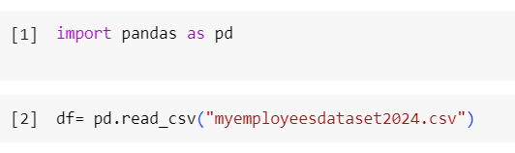
Read csv dataset

Slide 5
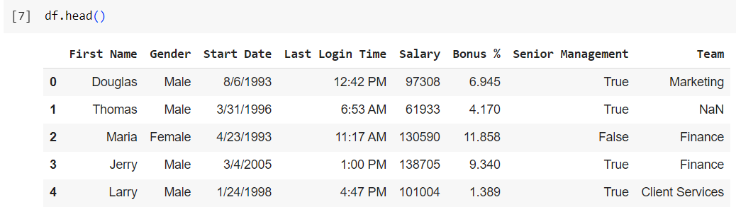
Pandas - Analyzing DataFrames
head() method returns the headers and a specified number of rows, starting from the top.

Slide 6
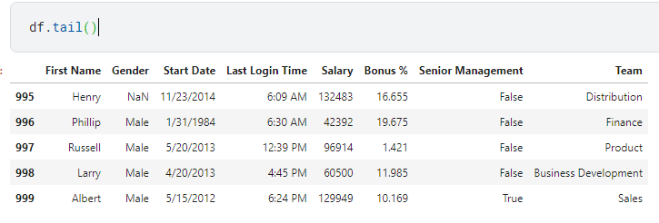
Using tail() for Data Exploration

Slide 7
Using info() to Examine Your DataFrame
you can acquire valuable insights into the following aspects of your DataFrame:
The total number of rows and columns it encompasses.
The data types associated with each individual column.
The number of non-null values present within each column, effectively pinpointing missing data.
An approximation of the memory usage by the DataFrame, providing an idea of its memory footprint.

Slide 8
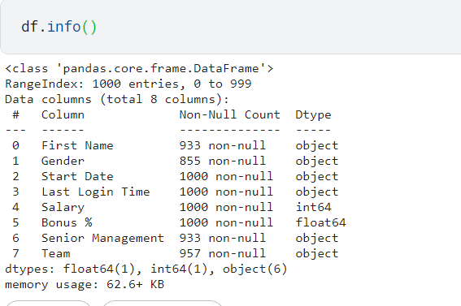

Slide 9
Key Statistics Revealed by df.describe()
Count: Denotes the total number of non-null values present in each numeric column.
Mean: Represents the arithmetic average of the values in each numeric column.
Std (Standard Deviation): Captures the degree of variability around the mean within each numeric column. A higher standard deviation indicates a more spread-out distribution of values.
Min (Minimum): Represents the lowest value present in each numeric column
Max (Maximum): Represents the highest value present in each numeric column.
Percentiles (optional): Provides quartiles (25th, 50th, and 75th percentiles) by default, offering a deeper understanding of the data distribution.

Slide 10
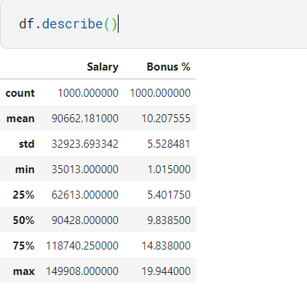

Slide 11
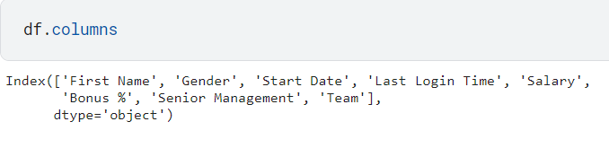
Accessing DataFrame Columns with columns

Slide 12
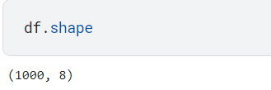
Understanding DataFrame Dimensions with shape

Slide 13
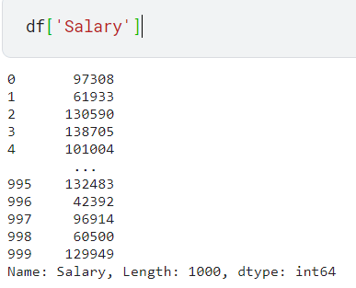
Selecting a Column

Slide 14
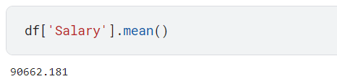
Calculating Average

Slide 15
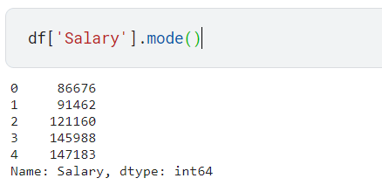
Finding the Most Frequent

Slide 16
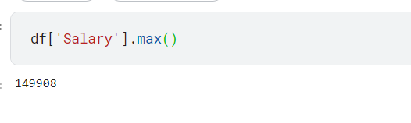
Finding the Highest value

